Slide 1
Ram Works

Slide 2
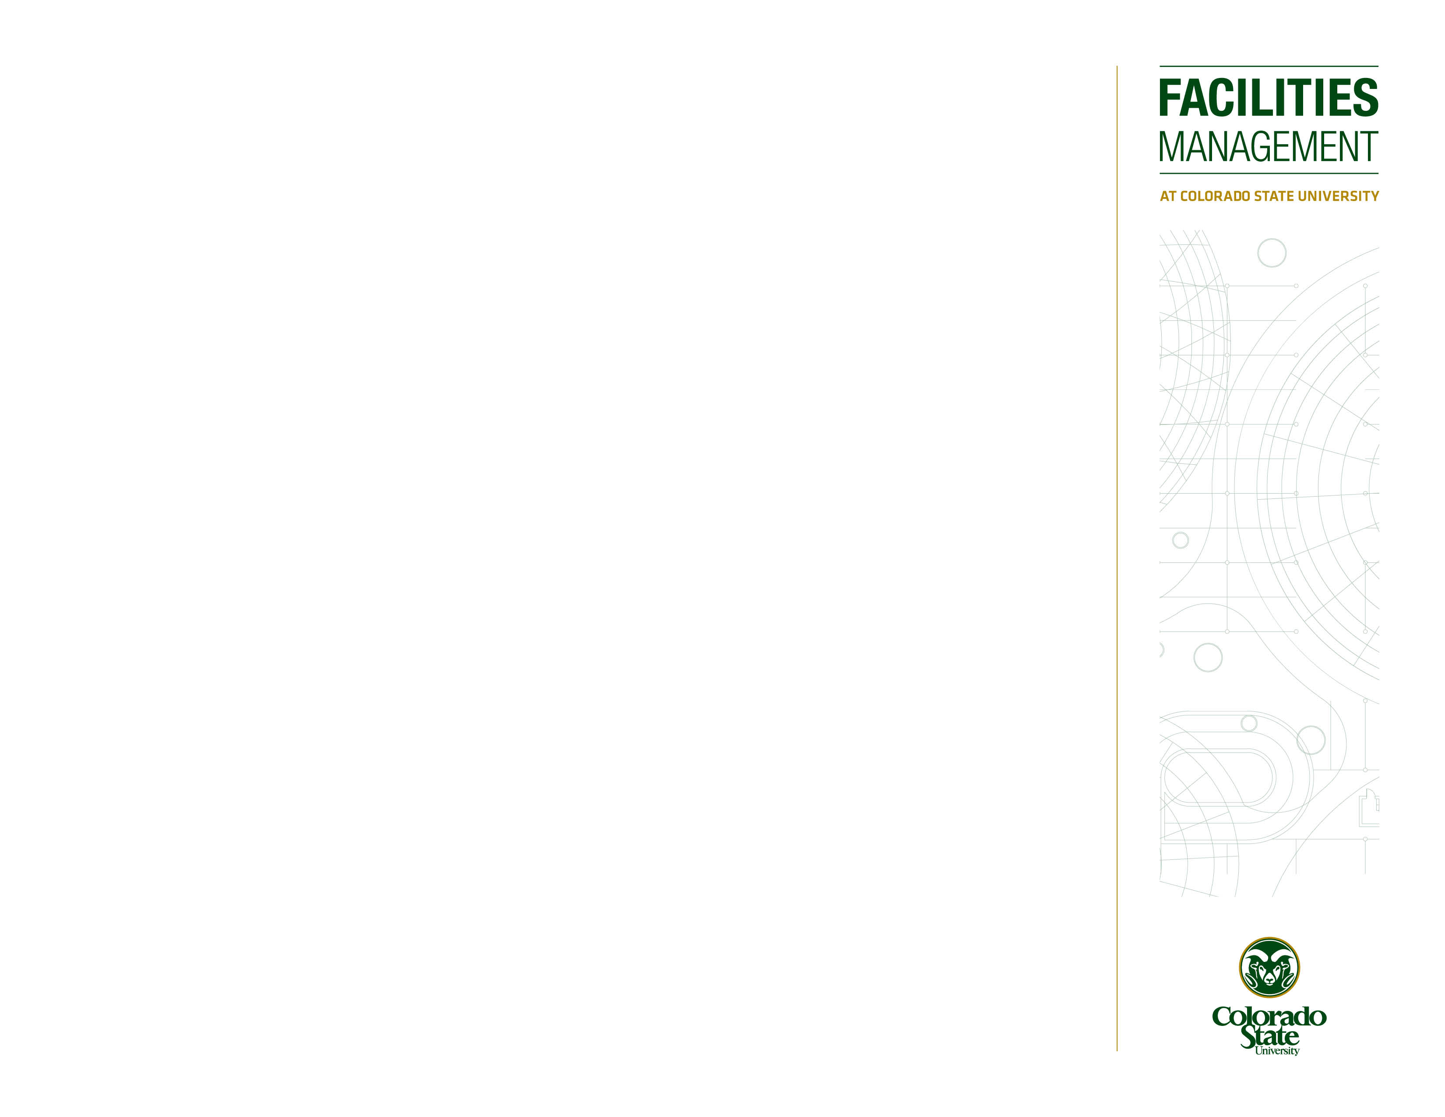
What is Ram Works
Ram Works is a collaborative service request system that is used to communicate between the requestor and the facilities management groups around campus.
With this system, you can:
Report maintenance needs around campus
View the progress of your requests
Communicate with the facilities team
Request Fee for Service work to be performed
Request service and view quotes for work
View Property information such as
Maps
Floorplans
Building contacts
Building addresses

Slide 3
Ram Works vs AiM
Depending on your departmental needs you may need access to AiM in conjunction with Ram Works. Here is a breakout of the differences between systems:
NOTE: AiM requires a paid partnership with Facilities in order to use
Ram Works
Facilities creates Work Orders from requests and performs the work
AiM
Department creates their own Work Orders to perform their own work
Department tracks their time on Work Orders
Department tracks inventory on their Work Orders
Requestor is notified when work is complete
Requestor can communicate with Facilities and track their submitted requests

Slide 4
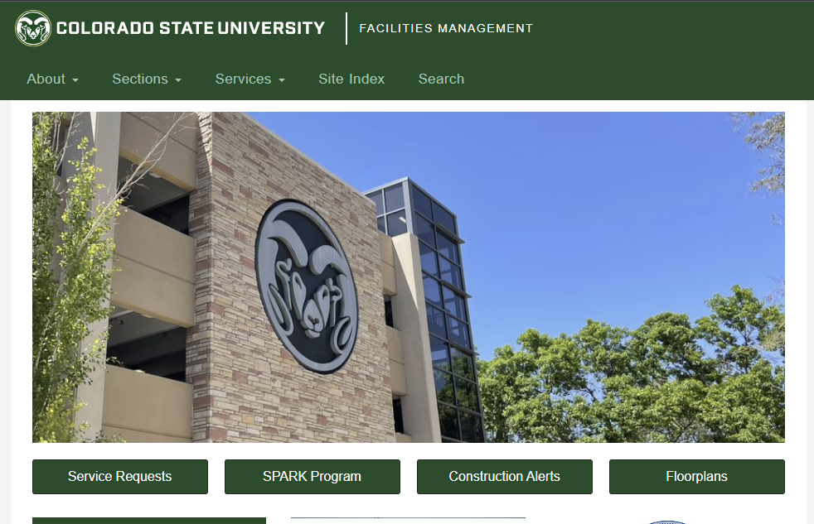
How to get to Ram Works
Ram Works can be accessed directly by going to:
https:\\ramworks.colostate.edu
Alternatively, Ram Works can be accessed through the Facilities Management website here:
https://www.fm.colostate.edu/alterations_repairs_maintenance/
Or from the Facilities Management homepage using the Service Requests button:

Slide 5
Using the System

Slide 6
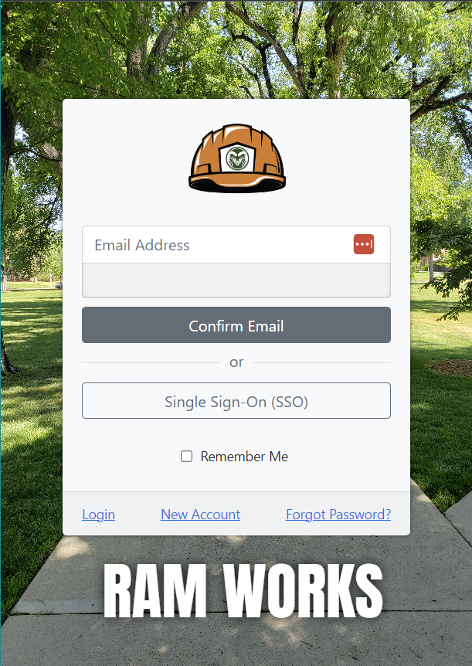
Logging In
If you have a CSU netid
Click the Single Sign-On (SSO) button and sign in using your netid credentials
Do not have a CSU netid (public)
Click New Account to setup an account.
Then type your personal email address into the Email Address box and click Confirm Email

Slide 7
Configuring your User Profile
Once you log into Ram Works, you will need to configure your User Profile. This will ensure your contact information is accurate and that you are able to receive the emails you need.
On the Ram Works Home Screen, click the Settings dropdown on the top left of the screen, then choose User Profile

Slide 8
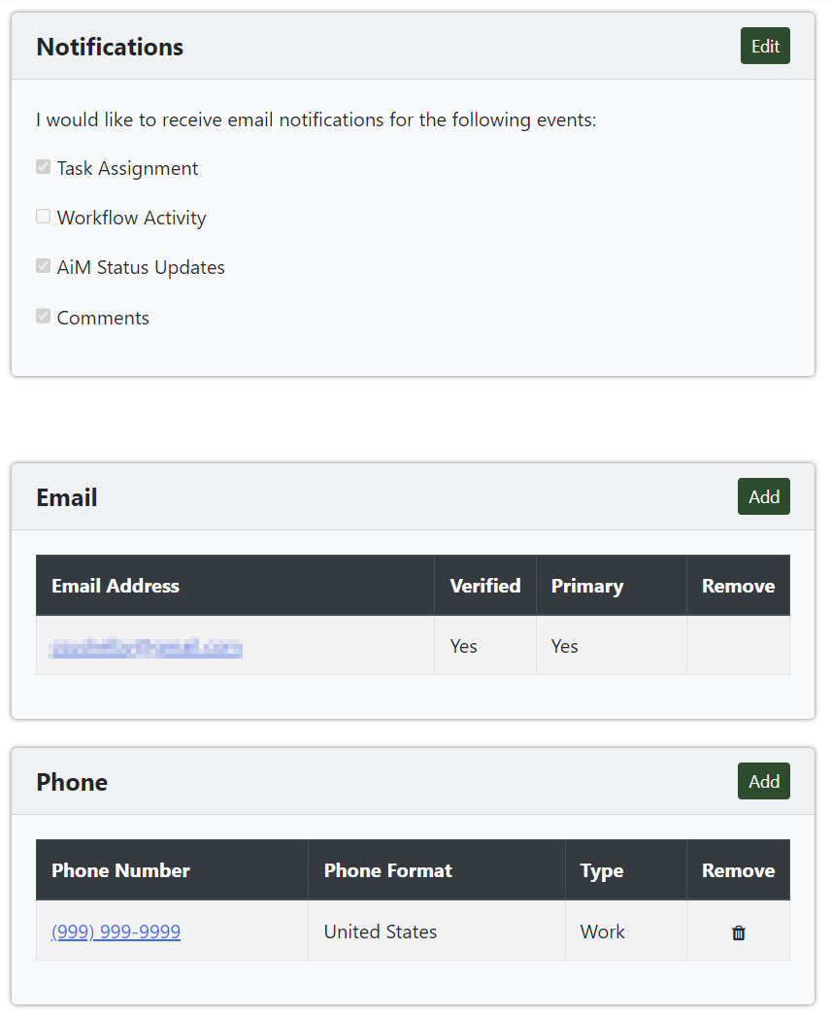
Configuring your User Profile (cont.)
Once you are on the User Profile Screen, configure the following settings:
NOTE: Make sure to click the Edit then DONE in each section that you make changes to
Notifications – Choose which types of notifications you would like to receive. These are the recommended settings:
Email – Make sure to verify your email in order to receive notification. You can add multiple email addresses if needed
Phone – Add a phone number that will autofill in your requests
Delegates – Manage your delegates to receive responses to your requests when you are away. Be sure to remove them when not needed

Slide 9
Submitting a Request

Slide 10
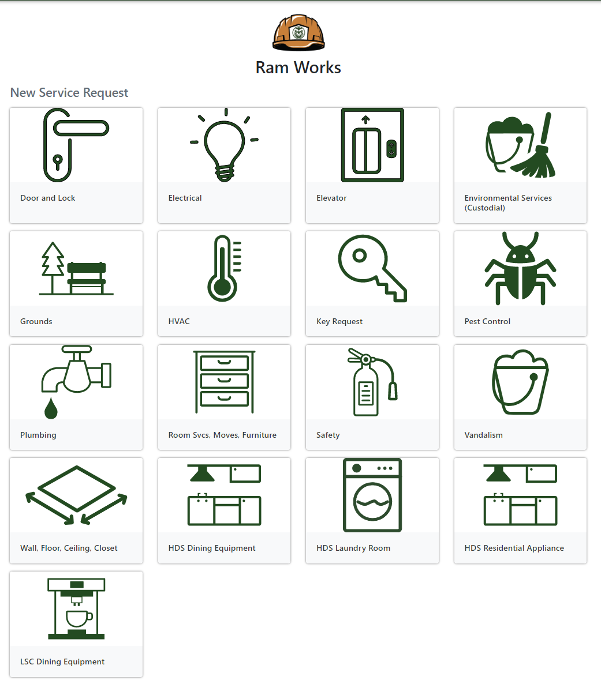
Types of Requests
There are different types of requests that you can submit within Ram Works. Depending on the request, additional action may be required. As we continue building out the system, more types of requests will be added.
Requests are submitted using the tiles shown in the following screenshot. Click into a tile and complete the request form.
General Maintenance
Any maintenance issue around campus that requires facilities to perform repairs. These requests do not have any associated charge connected to them

Slide 11
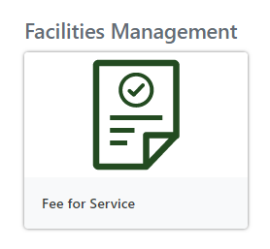
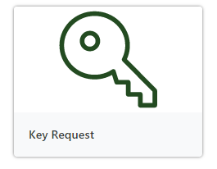
Types of Requests (cont.)
Fee for Service
Any request for improvements around campus that has an associated charge connected to them
These requests required additional action by the user.
The user must respond the request and approve any attached quotes.
Please see the Fee for Service guide for more info
Key Requests
You can request keys by using the Key Request tile
This is intended to be used by Key Managers to request keys for their users

Slide 12
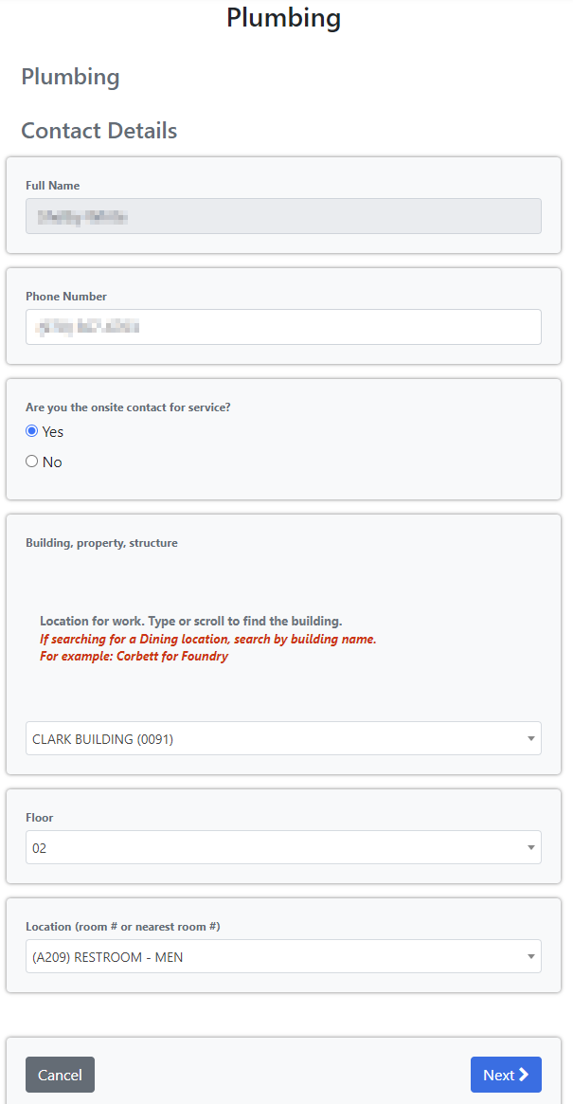
Submitting a Request
Each tile acts as a form that will guide you through the completion of the request.
Click into a tile that best fits your request needs
Your contact info will be auto filled using the info from your User Profile
Click through the required dropdowns and checkboxes to fill in the request info
Fill in the Additional Information box to provide as much information as possible to facilities
Attach documents as needed
Once you have clicked through all the screens, be sure to click Review and Submit on the last two screens
You will receive emails updating you on the progress of your request

Slide 13
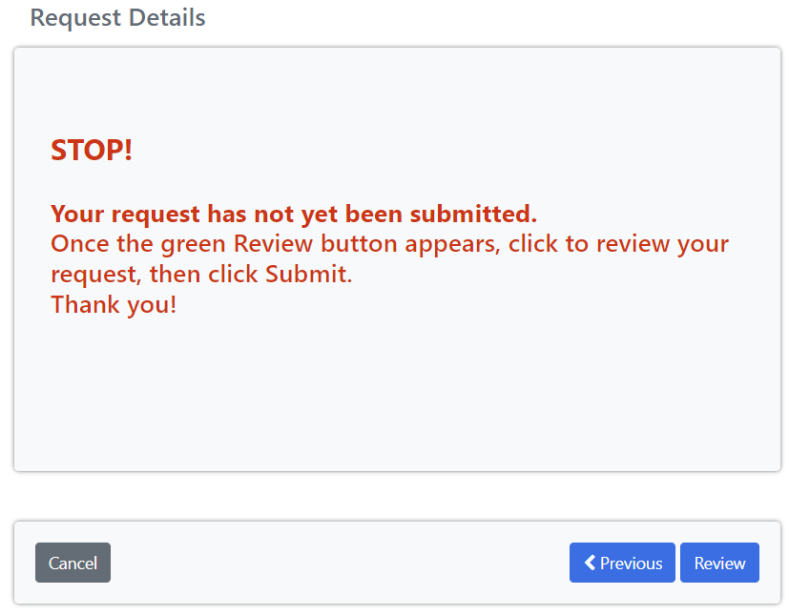
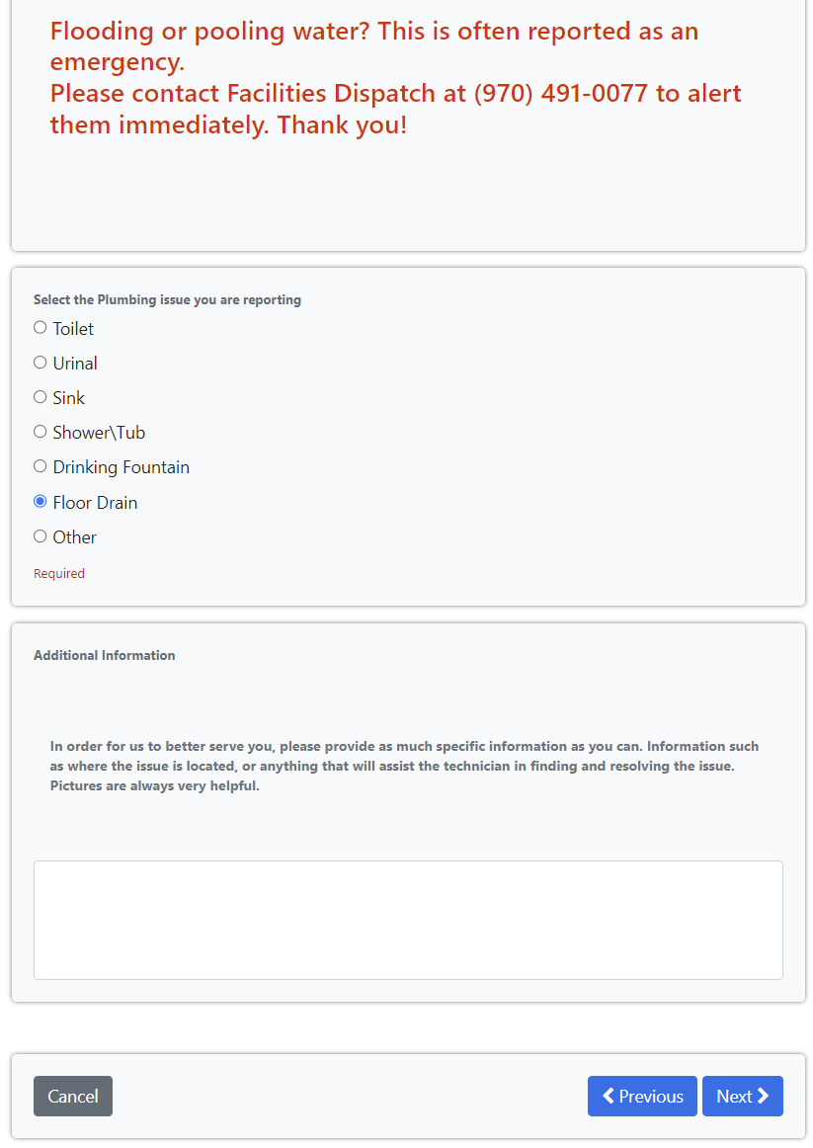
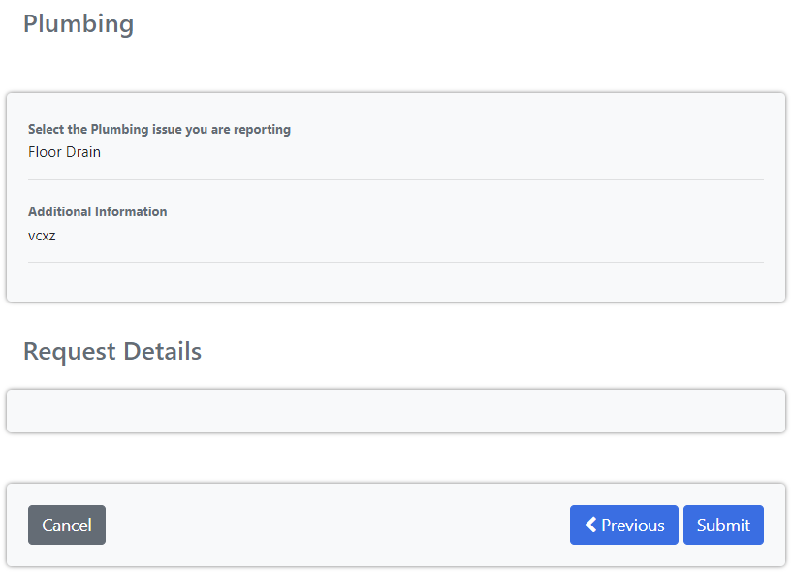
Submitting a Request (cont.)
Example request options:

Slide 14
Email Notifications

Slide 15
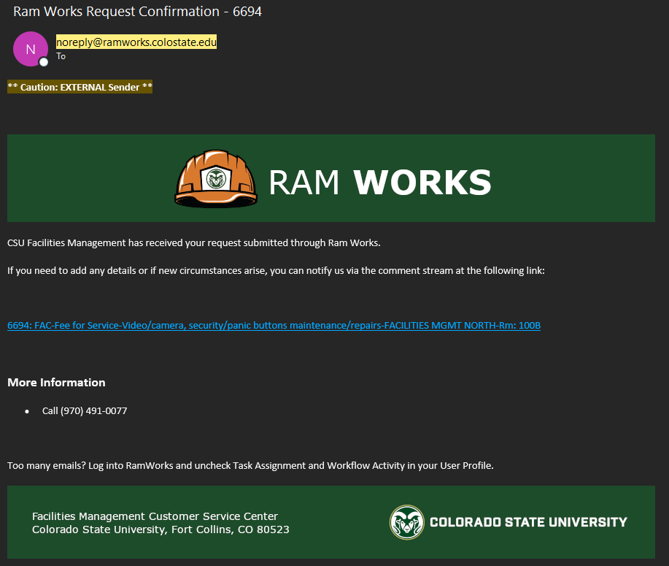
Email Notifications
You will receive email notifications after your request is submitted. Be sure to watch for emails coming from the following email address:
noreply@ramworks.colostate.edu
You will receive an email when:
Your request is submitted
A task needs your attention
Someone comments on the request
The request has been created into a Work Order
The request Work Order is completed, closed and\or cancelled
The following slide illustrates examples of commonly sent emails

Slide 16
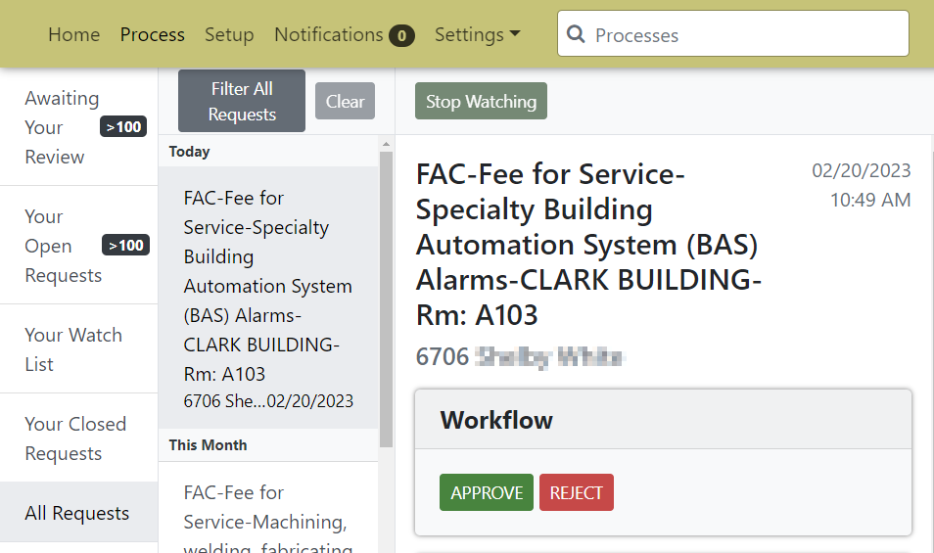
Types of Emails
You can manage the types of emails you receive in your User Profile.
Task Assignments – You have pending tasks that you need to do on the request
Click the link to the request and click an available button to complete the task

Slide 17
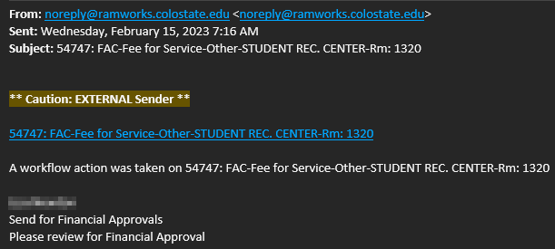
Types of Emails
Workflow Activity – Notifies when a user has taken an action on the request. It is recommended to turn these off if you are receiving too many emails
AiM Status Updates – Lets you know when a Work Order has been created, completed, closed, and\or cancelled
Comments – Notifies you when someone has commented on the request. This is important to communicate with facilities

Slide 18
Managing Requests

Slide 19
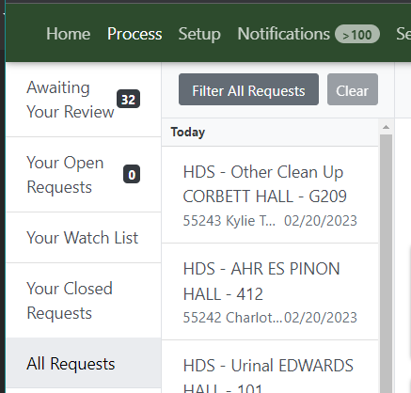
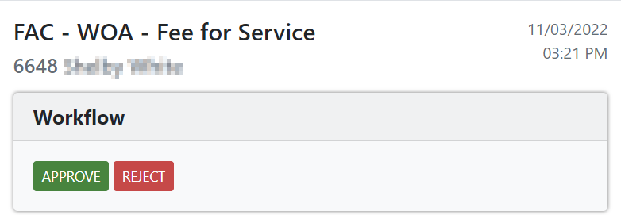
Managing your Requests
Ram Works provides the ability to log in and view all your submitted requests.
To access your requests, log into Ram Works and click the Process tab on the top left of the screen.
In the system you can:
View requests that are:
Awaiting your Approval
Requests that need you to complete a task
Open Requests
Requests you have submitted that are still open
Requests you are watching
Requests you are watching. This can include other user’s requests that they have commented your name on
Closed Requests
Requests you have submitted that are now closed
All Requests
All your submitted requests
Respond to task assignments on a request

Slide 20
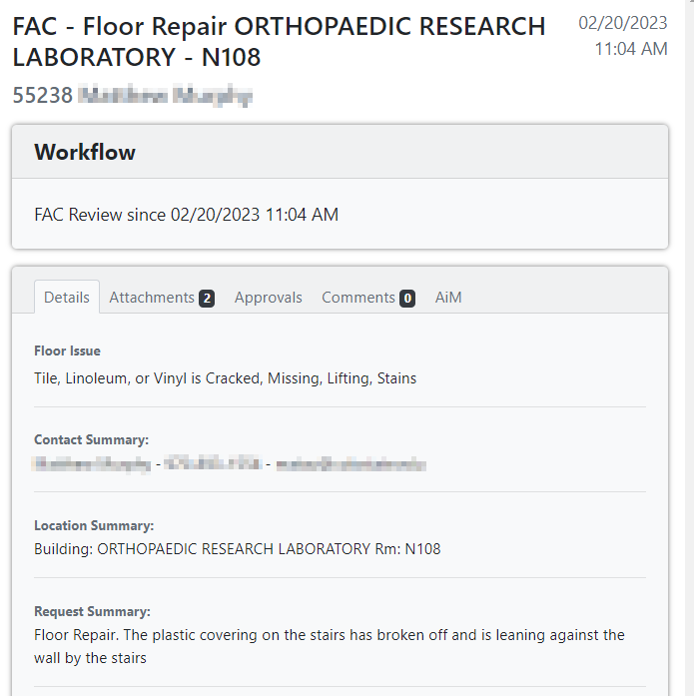
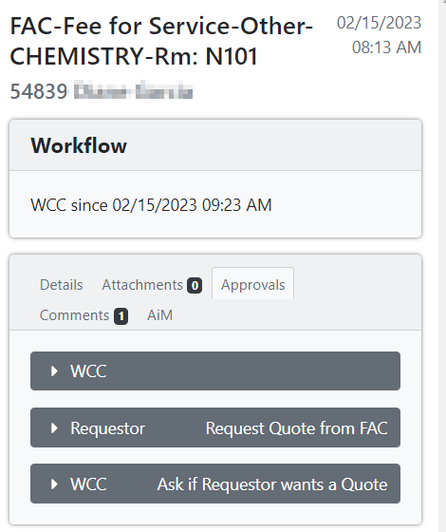
Managing your Requests (cont.)
View the submitted details of a request
View approval history of a request

Slide 21
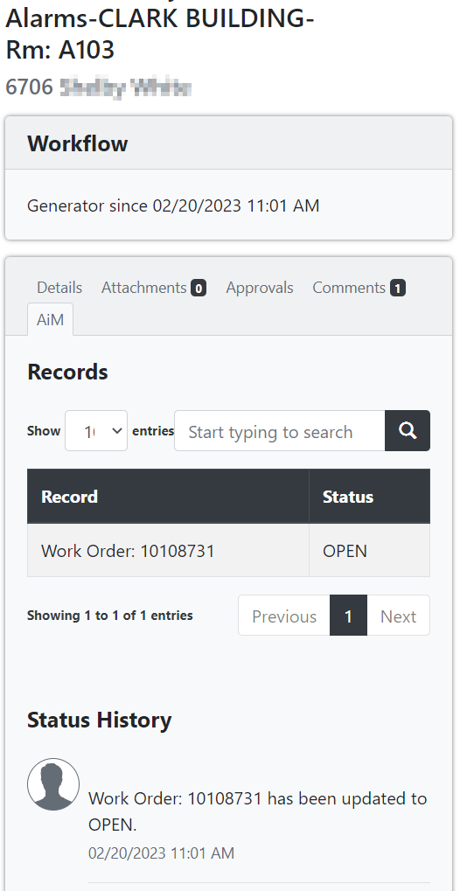
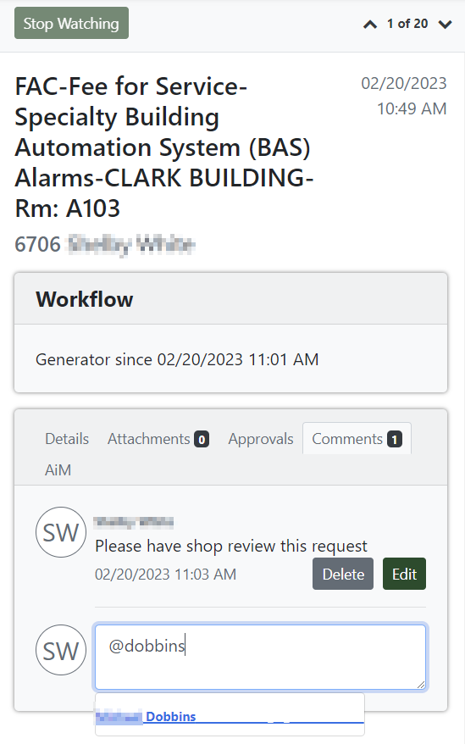
Managing your Requests (cont.)
Comment on any of your submitted requests to communicate with facilities
@ a user to add them as a Watcher on the request. They will then receive emails for updates on the request
Watchers can click the Stop Watching button at the top of the request to remove themselves from further updates
View associated Work Orders and their status

Slide 22
